Slide 1
Recitation 9

Slide 2

Recitation Schedule
MIDTERM PREP, YOU GUYS GOT THIS!!!!

Slide 3
MUST HAVE NOTES
The following slides contain notes you should have written down to use for your exam!

Slide 4
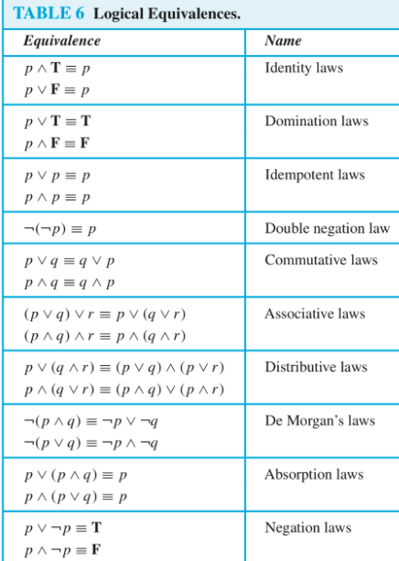
Logical Equivalence Table

Slide 5
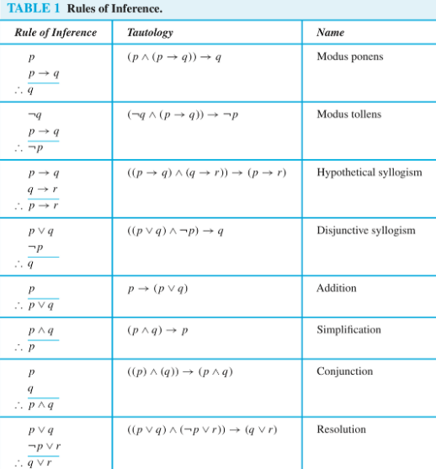
Rule of Inference Table

Slide 6
3 Variable Truth Table
p | q | r
T | T | T
T | T | F
T | F | T
T | F | F
F | T | T
F | T | F
F | F | T
F | F | F

Slide 7
Proving Something is a Tautology
Using logical equivalences
Making a truth table (easier option if the expression is short)

Slide 8
Proof Methods
Know the following methods to prove a statement and when to use them (all questions on the exam will require some proof method to prove!)
Contraposition
Contradiction
Case Analysis
Induction
Direct Proof
TIP:
If it says “prove for all integers” or something similar, that’s induction because you have to prove it’s true for n+1
If you just have to prove some statement is true, you most likely need to use contraposition or contradiction

Slide 9
Representing Numbers
Even: 2k CANNOT USE SOMETHING LIKE 4k
Odd: 2k+1
Rational: p/q where the greatest common factor between p and q is 1 (so p/q is simplified)

Slide 10
Even and Odd Numbers
Even + Even = Even
Even + Odd = Odd
Odd + Odd = Even
Even*Even = Even
Even*Odd = Even
Odd * Odd = Odd

Slide 11
Irrational Numbers
Sum/Difference of two irrational numbers is SOMETIMES irrational
Irrational + Irrational = Irrational OR rational
Irrational: √(2) + √(2) = 2√(2)
Rational: √(2) + (1-√(2)) = 1
Sum/Difference of an irrational and rational number is irrational
Product/Quotient of two irrational numbers is SOMETIMES irrational
Rational: √(2) * √(8) = √(16) = 4
Product/Quotient of an irrational number and rational is irrational

Slide 12
Prove the following statement: “√2 is irrational”

Slide 13
Prove the following statement: “√2 is irrational”
What proof technique should we use?
Induction? No, because we’re only proving that a single number is irrational
Contraposition? No, because the statement isn’t in a p → q form
Case Analysis? No, there are not multiple cases
Thus we use contradiction!
Notes:
Contradiction: √2 is rational.
What does it mean when a number is rational, how can we represent it?
It means we can represent it in a fraction form p/q where p and q are integers whose greatest common divisor is 1 (in other words, p/q is simplified)
√2 = p/q
2 = p²/q²
2q² = p²
What does this say about p²? That it’s even! Thus p is even because even*even=even and odd*odd=odd
Because p is even, how can we represent it? As 2k
2q² = (2k)²
2q² = 4k²
q² = 2k²
What does this say about q²? That it’s even! Thus q is even because even*even=even and odd*odd=odd
So p and q are both even. What’s wrong about this?
p and q are only allowed to have a greatest common divisor of 1, but since they’re both even their GCD is 2!

Slide 14
Strong vs Weak Induction
Strong and weak induction are actually very similar!
Weak Induction: P(n) is true, prove P(n+1)
Strong Induction: P(1) ∧ P(2) ∧ … ∧ P(n) are true, prove P(n+1)
Have to prove more than 1 values in our basis
This allows us to use values such as n-3 in our proof

Slide 15

Practice Midterm #2.4
p1 | p2 | p1 ⊕ p2 | p1 ∨ p2 | p1 ⊕ p2 → p1 ∨ p2
T | T | F | T | T
T | F | T | T | T
F | T | T | T | T
F | F | F | F | T

Slide 16
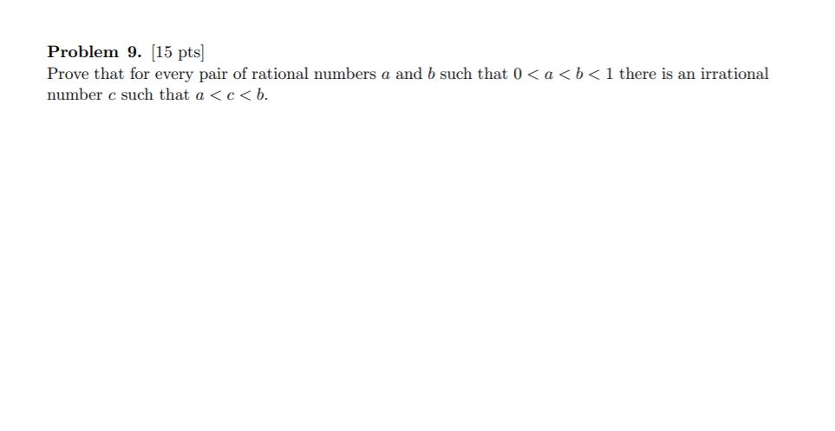
Notes:
Try to find some way to represent c in terms of a AND b (has to be in terms of both a and b)
The most standard way is having
c = (b-a)/sqrt(2)
This is valid because b-a is a rational number and sqrt(2) is irrational, thus c is irrational
We also have to prove that a < c and c < b
Let’s prove a < c
a < (b-a)/sqrt(2)
Now we can leave c equal to this, but as you can see it’d be much easier to have c = a + (b-a)/sqrt(2) which is valid as long as a < c < b
Why can we add a just like this? Because we just need there to be SOME irrational number between a < c < b so we can do whatever we want as long as it is within the interval.
So now lets have c = a + (b-a)/sqrt(2)
Refer to the practice midterm answer key for the rest of the solution.

Slide 17
Prove the following statement: “Every amount of postage that is at least 12 cents can be made from
4-cent and 5-cent stamps”
Notes:
How many cases do we have to prove in our base case? Prove 4, because if we know the first four numbers are valid then we just add 4 to each of the first four numbers to get the next four numbers!
Basis:
Prove 12 cents
Prove 13 cents
Prove 14 cents
Prove 15 cents
Induction: k = 4m + 5n
Prove k+1 for values k >= 16
k >= 12
Add 4 to both sides
k + 4 >= 16
k + 1 = 4(m+1) + 5n

